Slide 1

Year 6
HASS: civics and citizenship
Lesson 6 – rights and responsibilities

Slide 3
You will need
A pen or pencil.
Paper or an electronic device.
Independent activity from lesson 5.

Slide 4
Review of lesson 5 – migrant activity Let’s check your answers.
I think His Excellency the Honourable Hieu Van Le AO, Governor of South Australia chose to become an Australia citizen because he realised that Australian citizenship would fulfil his dream ‘to live in a peaceful, safe and free country and to live a meaningful and fulfilling life’. Prior to arriving in Australia, His Excellency, the Honourable Hieu Van Le AO, Governor of South Australia had lived in a difficult and dangerous situation. His life had been filled with war, fighting and suffering in Vietnam. I think, His Excellency, the Honourable Hieu Van Le AO, Governor of South Australia saw Australian citizenship as an opportunity to belong to, and participate in, a country where its citizens value the right to live peacefully and harmoniously with one another; something which he valued himself.
Highlighted text: Australian shared values

Slide 5
Learning intention
To understand how rights impact daily life and connect to citizenship.

Slide 6
Vocabulary check Get out your vocabulary table from the previous lesson. Add the words and definitions below.
Word | Definition
Rights | Is something a person has which people think should not be taken away. It is a rule about what a person is allowed to do or have.
Responsibilities | Means being dependable, making good choices, and taking accountability for your actions.
Human rights | Belong to all of us, regardless of who we are or where we live, and they cannot be taken away. They are the things we need in order to thrive and participate fully in society, and they protect every person’s individual dignity.
Dignity | Being treated with respect and treating others with respect.
Key words
Definition
Civics
Civics is what we ‘know’ about government and how our society is governed and knowing how rules and laws affect our lives.
Citizenship
Citizenship is about joining in with our community, and what we ‘do’ to participate in and contribute to society.
Citizen
A person who lives in a particular town or city.
Community
A group of people that live in the same place or belong to a common group.
Values
Standards of behaviour that are important in a person’s life or important to a group.
Democracy
A type of government where the power is in the hands of the people where they can use their power directly, or through people who represent them.

Slide 7
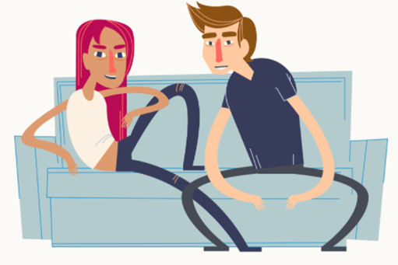

Introduction to rights and responsibilities
Did you know?
Human rights involve responsibility toward other people and the wider community.
Individuals have a responsibility to ensure that they use their rights, while also thinking about the rights of others. Acting with respect for the rights of others helps people to live together in harmonious communities.
Human rights are for everyone.

Slide 8
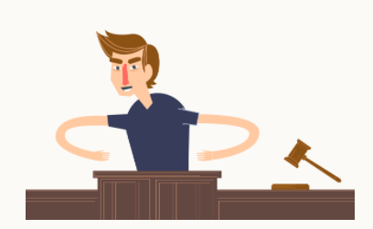
Introduction to rights and responsibilities
Did you know?
Our human rights cannot be taken away from you.
Everyone has the right to be treated fairly and equally.
However, this doesn't mean that abuses and violations of human rights don't occur.

Slide 9


Human rights are the rights we have as humans
For example:
rights to have something (positive rights)
the right to health
the right to education
rights to be free from something (negative rights)
the right to be free from slavery
the right to be free from discrimination.

Slide 10
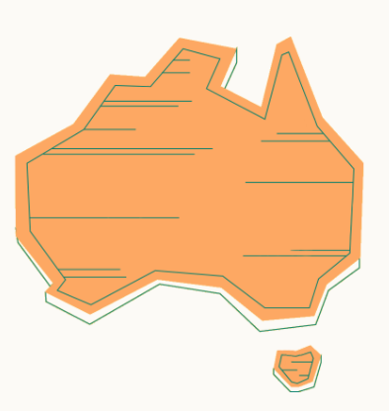
Human rights and values
Many of the values that underpin human rights are important values in Australia’s democracy.
Moral and ethical values determine what people think is right and wrong and this is reflected in the law.

Slide 11

Underlying values of human rights
Equality
Respect
Freedom
Dignity
Justice
One of the key underlying values of human rights is the principle that you should ‘treat others as you wish to be treated’.

Slide 12
Human rights – making connections
Let’s revisit some learning from previous lessons about democracy and how laws are made and connect it with values of human rights.
See if you can complete this sentence:
Ideas from citizens in the community can possibly become a l__ which is debated in p____________. The g_________ amends or introduces laws that reflect the v____ of the society.

Slide 13
Human rights – making connections
Let’s check the answers.
Ideas from citizens in the community can possibly become a law which is debated in parliament. The government amends or introduces laws that reflect the values of the society.

Slide 14
So why are human rights important?
Human rights:
are necessary for people to live full and satisfying lives
are important for making sure that people are treated equally and fairly
recognise the value and dignity of each person
recognise the importance of mutual respect between people and help us to live together cooperatively.

Slide 15
Let’s recap
We learnt:
what rights are and how they impact on us as citizens living in Australia
what human rights are and the importance of them
about values that underpin Australian values and made connections to learning in previous lessons.

Slide 16
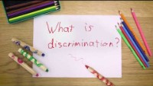
Independent activity – rights are important Watch the video to take a closer look at why human rights are important.
Source: Fair play: a simple look at why human rights are important on YouTube (Equality and Human Rights Commission, 2018)
For your safety, watch this video in the slideshow without accessing YouTube.

Slide 17
Independent activity – rights are important
Read through and answer the following questions to demonstrate your understanding of what you have learnt today. Give examples to support your thinking.
Is the right to education important?
What is discrimination?
What is freedom of expression?
Should everyone have the right to vote?
What are human rights?
Who is responsible for looking after rights?

